Slide 1

Accessibility Testing: A Vital Component
Understanding the importance of accessibility in development.
Tools and methodologies for effective testing.
Enhancing user experience for all.
Notes:
This opening slide aims to set the stage for the presentation on accessibility testing. We will explore the essential role it plays in development and user experience. Accessibility is not just a requirement but a fundamental aspect to ensure all users can engage with our products. We will discuss tools and methodologies that help in achieving this goal.

Slide 2

The Testing Philosophy & Setup
Foundation built on React Testing Library and jest-axe.
Accessibility testing focuses on user interaction.
Automated validation with every component scanned.
Global test configuration ensures compliance with WCAG 2.1.
Custom utilities streamline accessibility testing for components.
Notes:
This slide introduces the foundational elements of accessibility testing using React Testing Library and jest-axe. We emphasize the importance of testing as users interact, ensuring every component undergoes automated validation. The global test configuration is designed for WCAG 2.1 compliance. Additionally, we have created custom utilities for different component types, enhancing our testing efficiency.

Slide 3

Real Examples from Our Codebase
Accessibility testing in real components enhances user experience.
Closed and open states must be tested for navigation components.
Keyboard navigation is crucial for user accessibility.
Descriptive ARIA labels improve screen reader interaction.
Links must be both accessible and semantically correct.
Notes:
This slide presents practical examples from our codebase focusing on accessibility testing. We demonstrate how vital it is to test components in both open and closed states to ensure usability. The use of keyboard navigation and descriptive ARIA labels significantly enhances accessibility for users relying on assistive technologies.

Slide 4

Effective Testing Patterns for Accessibility
Prioritize queries based on assistive technology standards.
Test components for static, interactive, and dynamic accessibility.
Ensure proper ARIA compliance for labeling and relationships.
Utilize mock strategies to maintain accessibility structure.
Specialized functions streamline accessibility testing in navigation.
Notes:
This slide focuses on the best practices for testing accessibility within components. It emphasizes the importance of a query priority hierarchy that aligns with assistive technologies. We will explore how to ensure each component meets accessibility standards through comprehensive testing, including the use of mocks to preserve accessibility functionality.

Slide 5
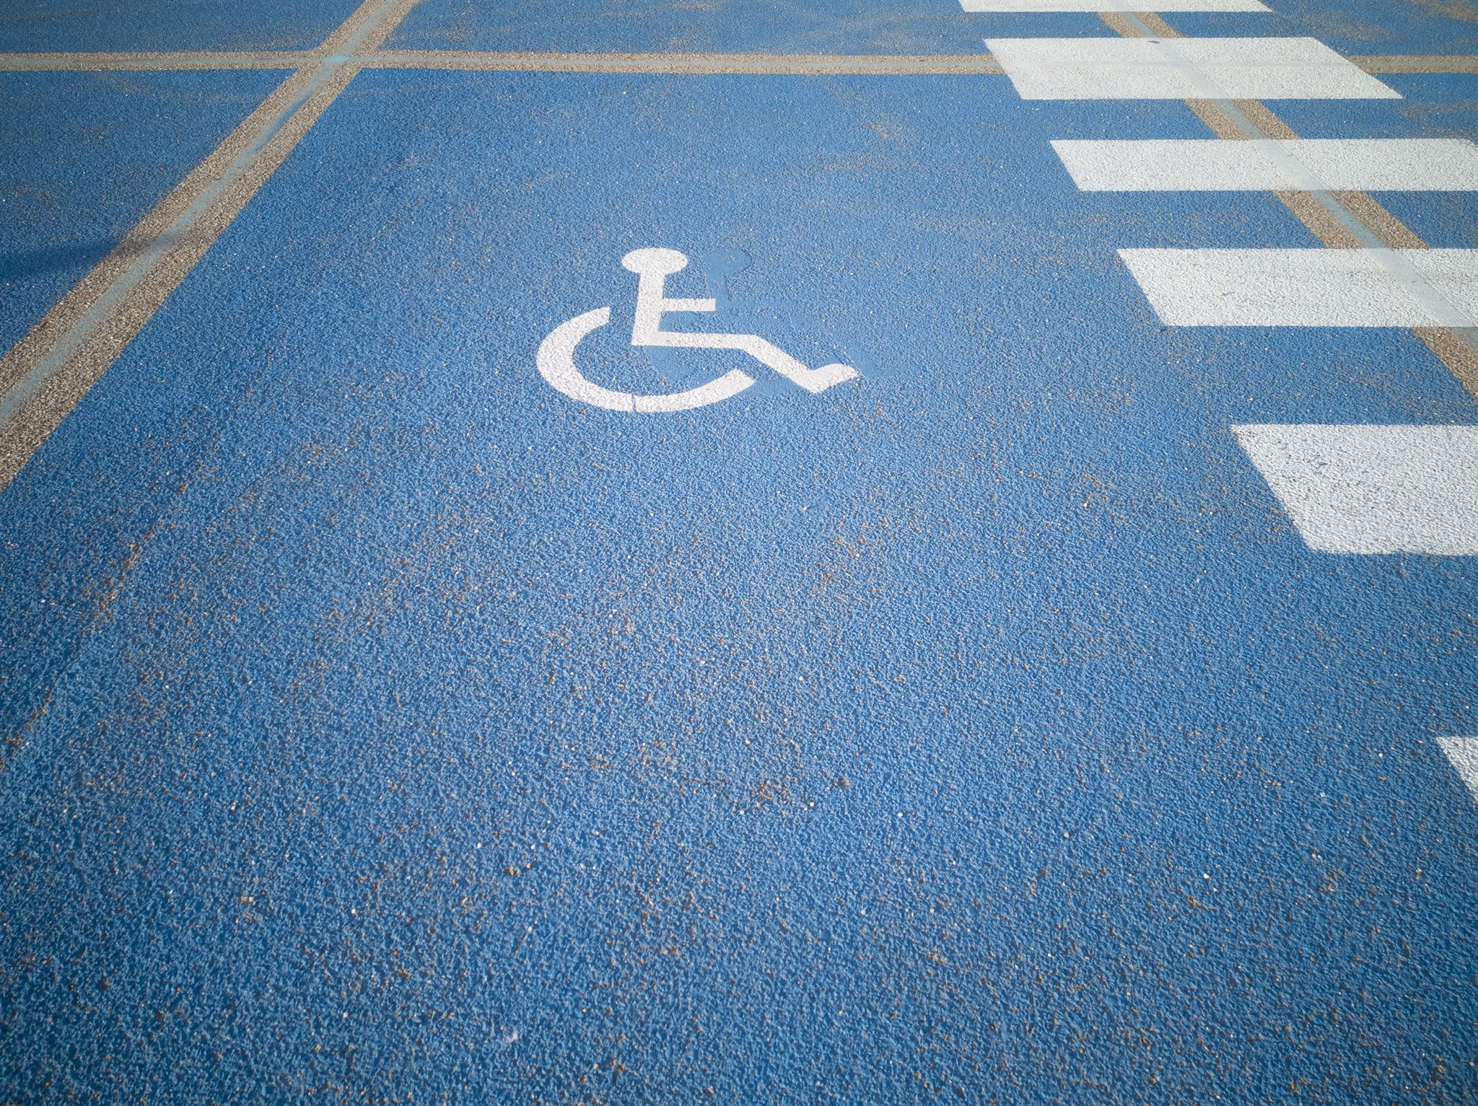
Measurable Impact of Accessibility Testing
95% of interactive elements have accessible names
100% of form inputs linked to labels
Zero accessibility regressions in the past 6 months
Automated tests ensure WCAG 2.1 AA compliance
Faster feedback loop identifies issues during development
Enhanced user experience for keyboard-only and screen reader users
Notes:
This slide highlights the significant impact of our accessibility testing efforts. We have achieved high compliance rates with critical standards, ensuring a better experience for all users. The faster feedback loop not only streamlines development but also fosters a culture of inclusivity, enabling all users, including those relying on assistive technologies, to navigate our applications effectively.

Slide 6

Final Thoughts on Accessibility Testing
Integrate accessibility into every development stage.
Utilize semantic testing for better clarity and focus.
Automate validation processes to minimize human error.
Focus on the entire user journey for inclusivity.
Ensure technology benefits all users in the yoga app.
Notes:
This slide emphasizes the importance of incorporating accessibility into the development workflow. By focusing on semantic testing and automating validation, developers can ensure that their applications, like the yoga app, are inclusive for all users. The principles of testing user journeys help create a seamless experience, ensuring that no user is left behind.

Slide 7
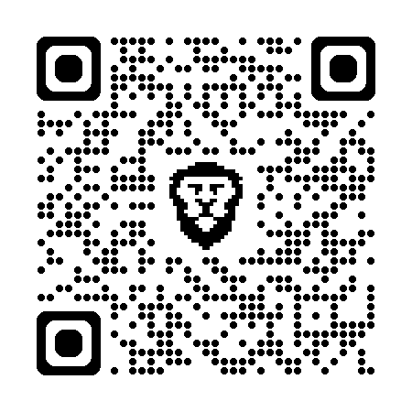
(Tre') Lewis King Grisby III
Front-End Engineer | Accessibility Advocate | Creator of the Soar Yoga App
linkedin.com/in/trewaters
github.com/Trewaters/soar
https://www.happyyoga.app/navigator

